Slide 1



latent: an R package for fast and general Latent Variable Modeling in R
Marcos Jiménez¹ Vithor Rosa Franco² and Mauricio Garnier-Villarreal¹
¹Vrije University of Amsterdam
²São Francisco University
September 30, 2025

Slide 2

Current software limitations for LVM
Commercial software (e.g., Mplus) is expensive and not open-source (e.g., LatenGOLD).
Free and open-source alternatives (e.g., poLCA, depmixS4, lavaan, mirt) are computationally slow and support a limited range of models.
So… what are we doing about it?

Slide 3

Current software limitations for LVM
Commercial software (e.g., Mplus) is expensive and not open-source (e.g., LatenGOLD).
Free and open-source alternatives (e.g., poLCA, depmixS4, lavaan, mirt) are computationally slow and support a limited range of models.
So… what are we doing about it?
We are building a free, open-source, efficient, and flexible software

Slide 4
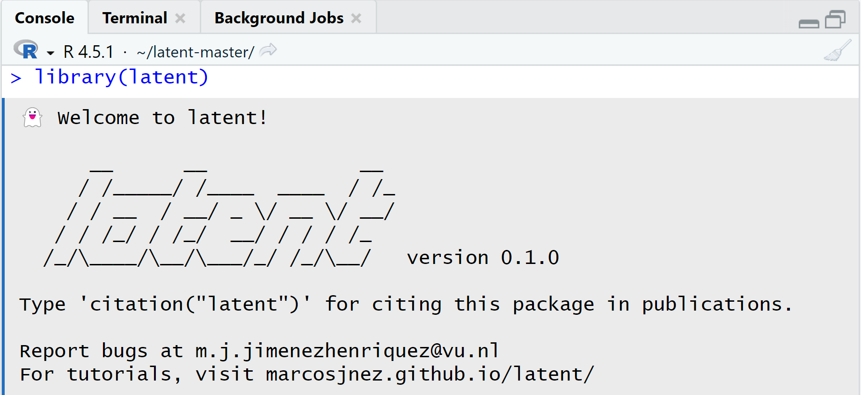

latent
Unified and flexible syntax
High-performance computing

Slide 5
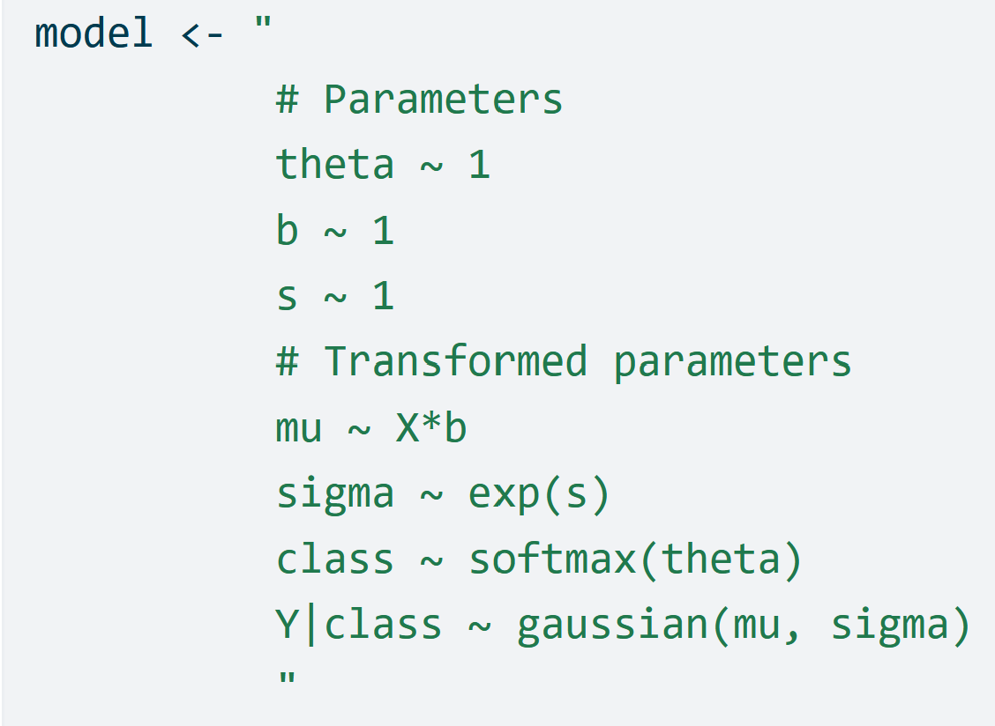

Features of latent
Unified and flexible syntax
Few arguments for a straightforward analysis
Customizable models

Slide 6
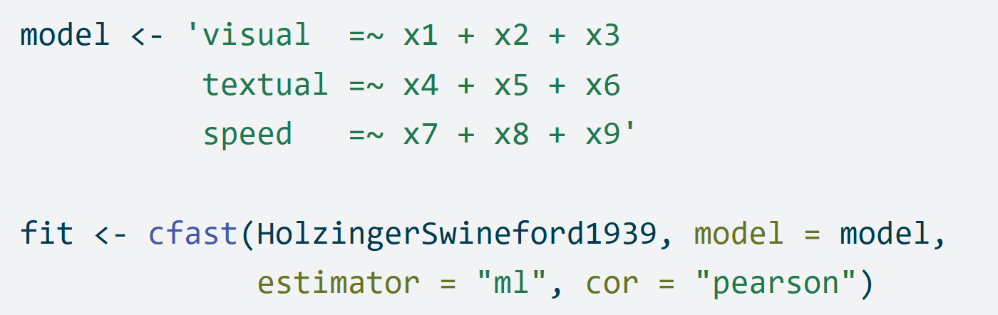
Features of latent
Sintaxis unificada y flexible
Few arguments for a straightforward analysis
We use lavaan syntax for Structural Equation Models
Customizable models

Slide 7

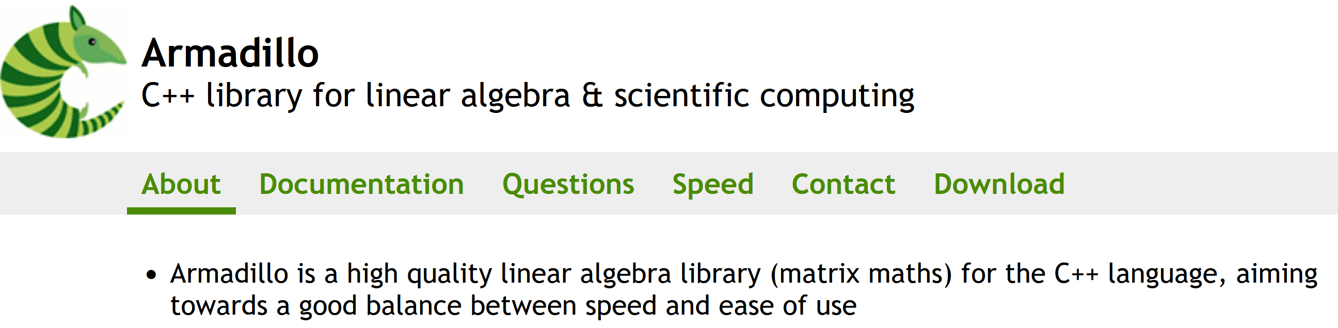

Features of latent
Unified and flexible syntax
High-performance computing
Core functions written in C++ with the armadillo library
Parallelization of multiple random starts to address local maxima

Slide 8
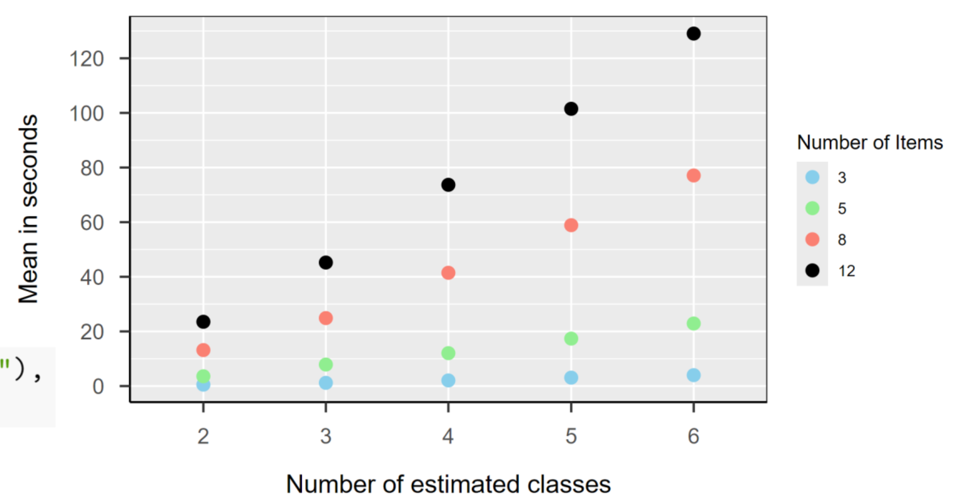



Scalability of latent
A small simulation:
• Number of latent classes: 2, 3, 4, 5, 6
• Number of items: 3, 5, 8, 12

Slide 9
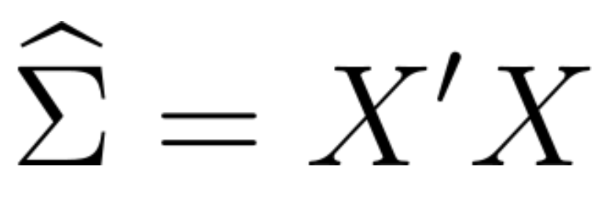
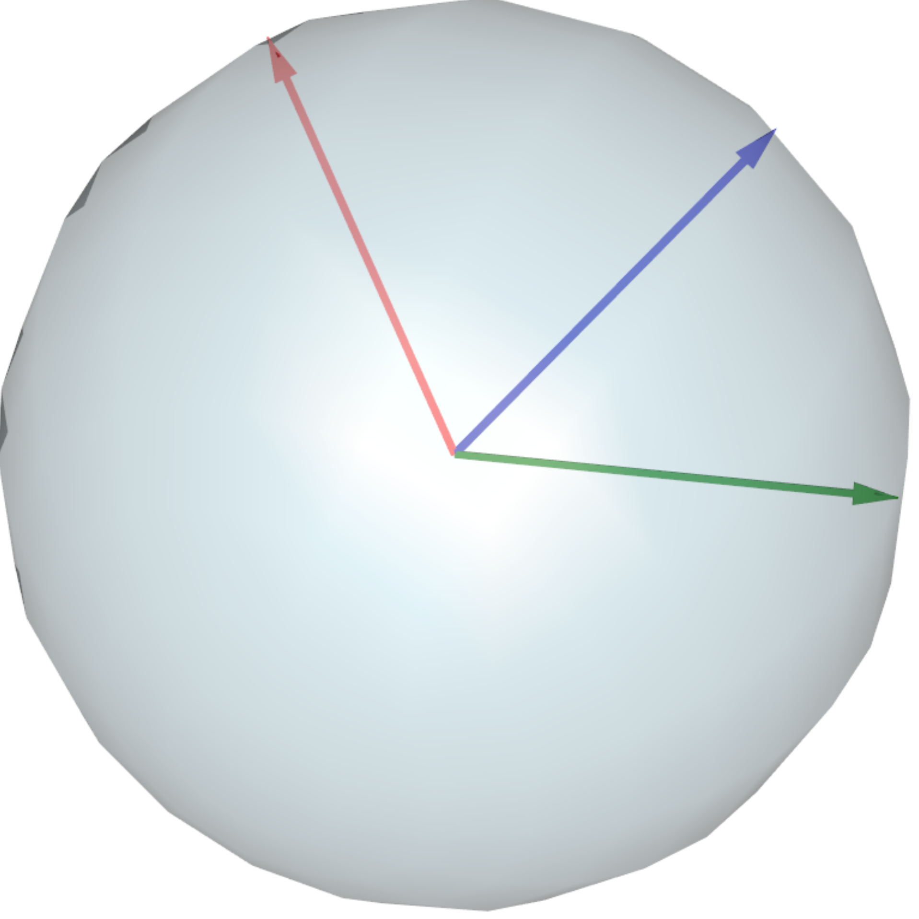
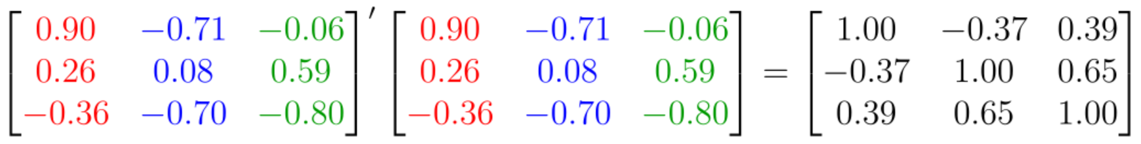
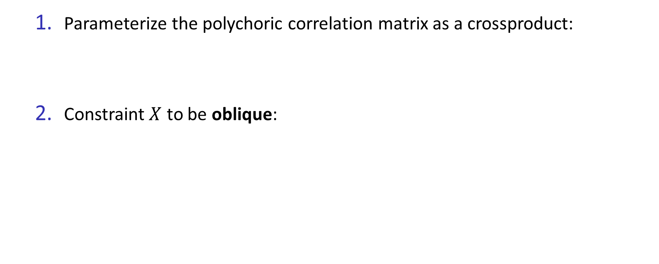


Positive-semidefinite polychoric correlations
Parameterize the polychoric correlation matrix as a crossproduct:
Constraint $X$ to be oblique:

Slide 10
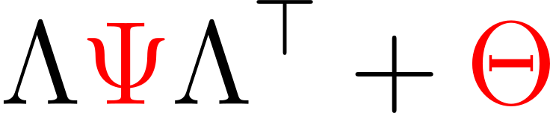

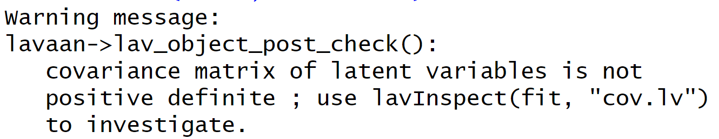
Positive-semidefinite latent covariances
Latent correlations and covariances should be at least positive-semidefinite but…

Slide 11

Positive-semidefinite latent covariances
Let’s do a small trick to avoid this message!

Slide 12

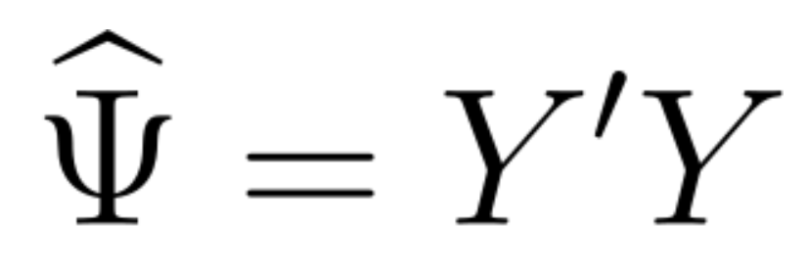
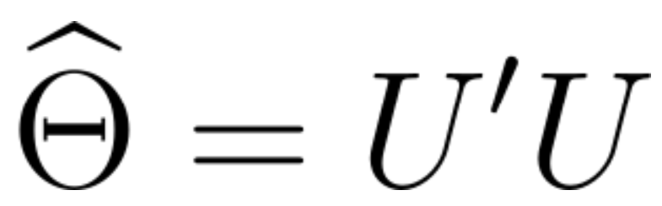
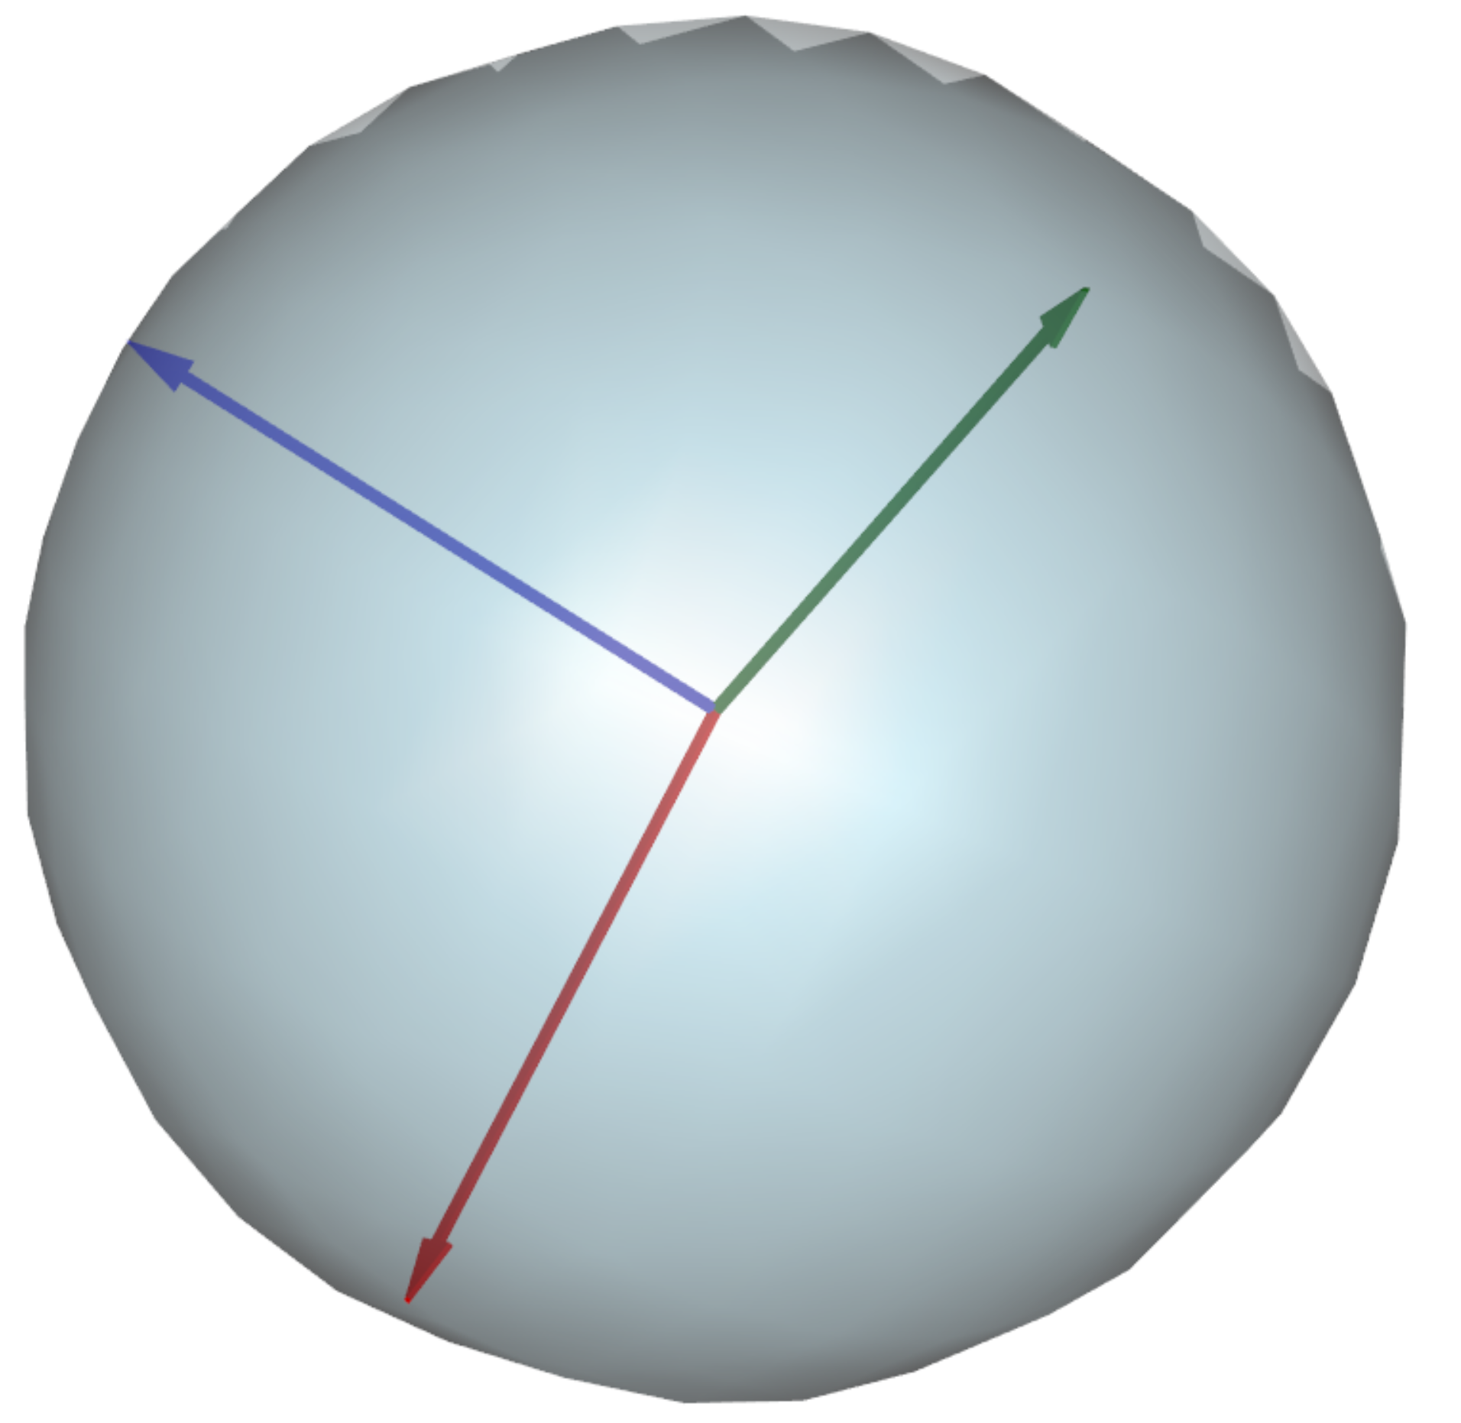
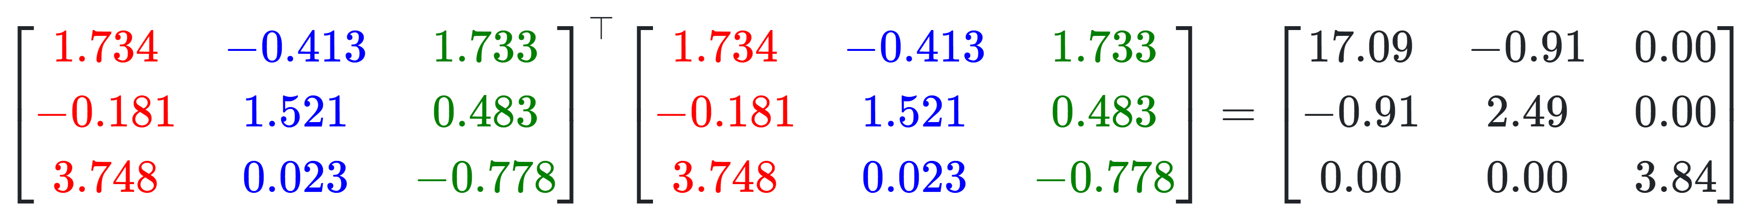
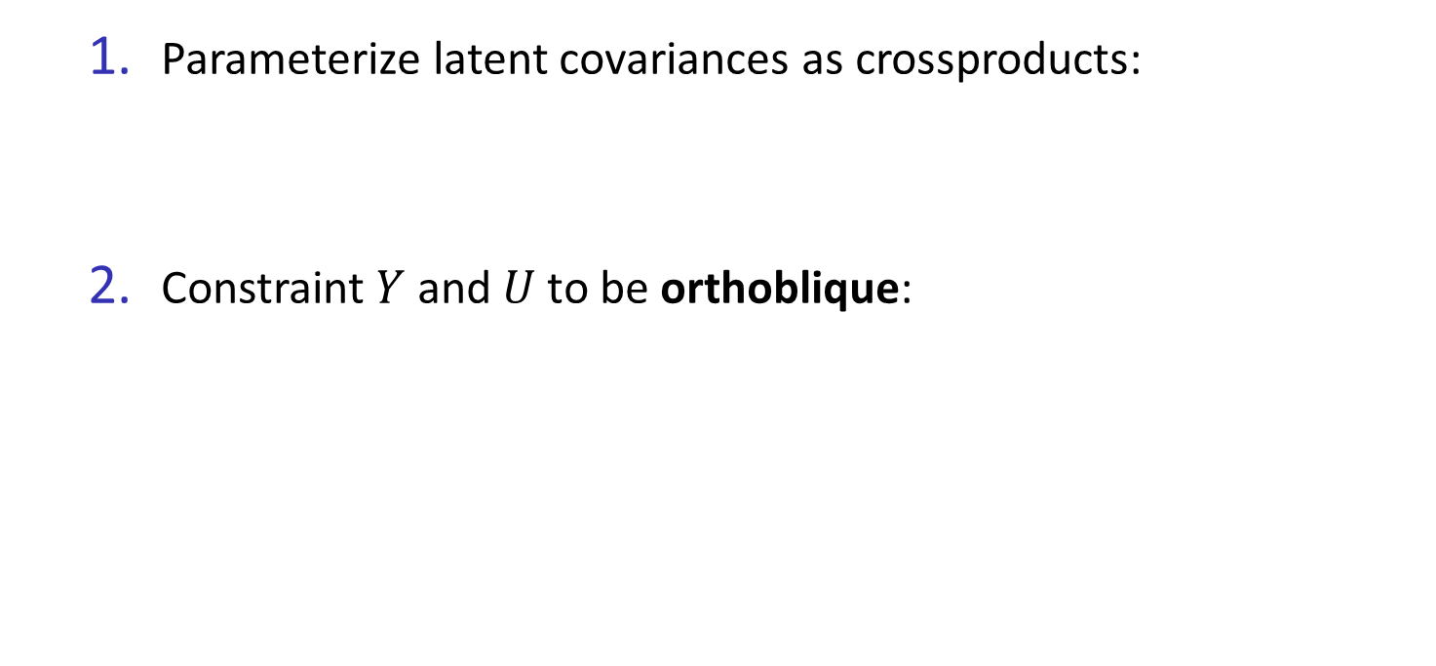

Positive-semidefinite latent covariances
Parameterize latent covariances as crossproducts:
Constraint $Y$ and $U$to be orthoblique:

Slide 13
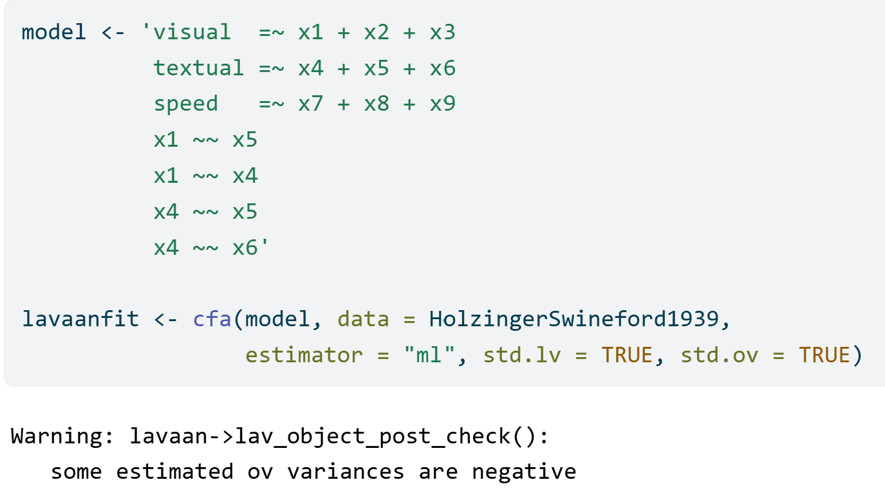
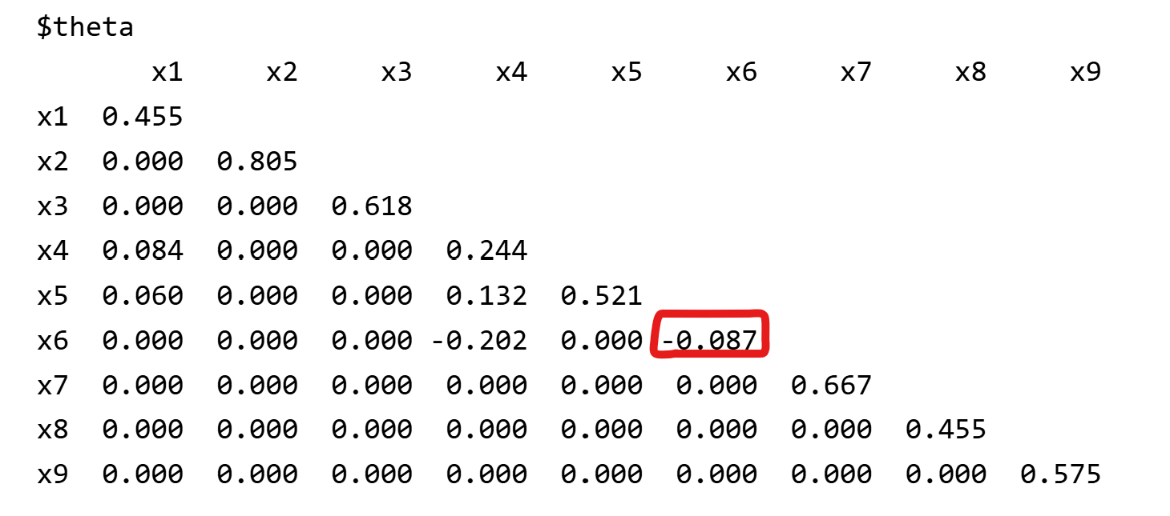
Positive-semidefinite latent covariances: an example
Negative variances with lavaan

Slide 14
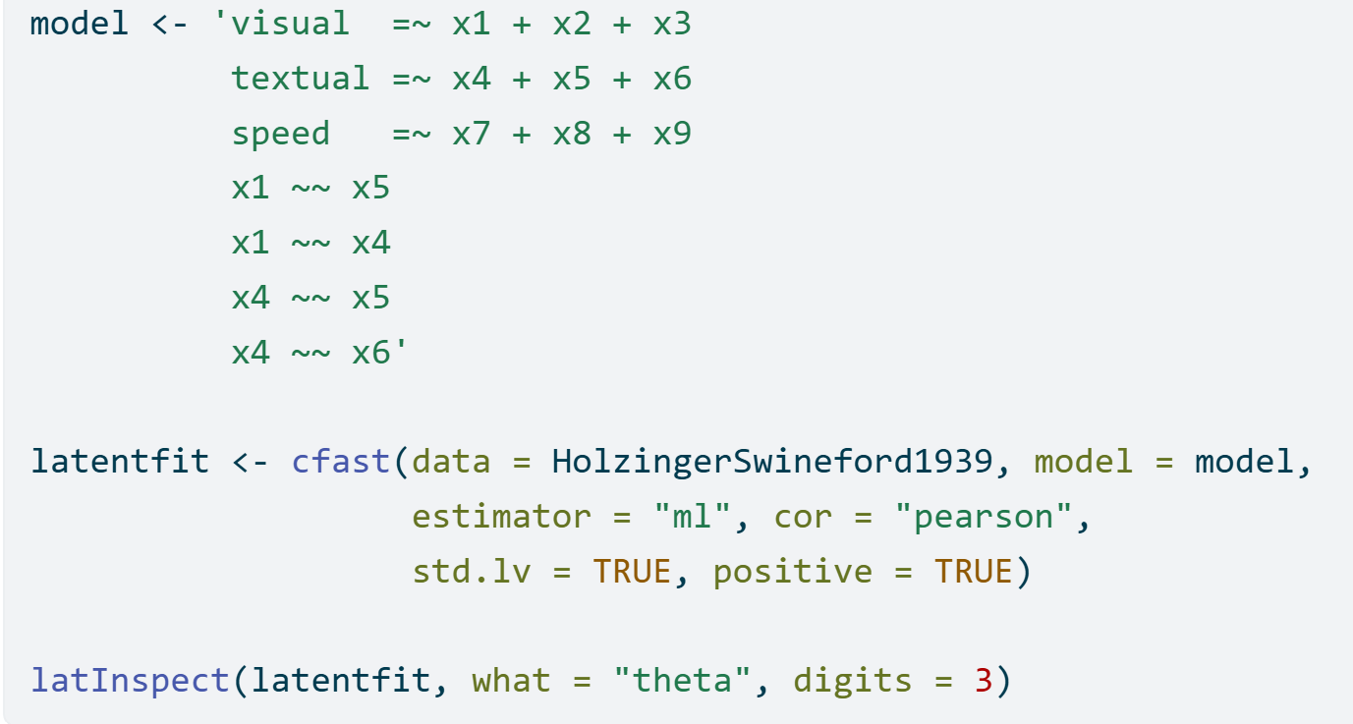
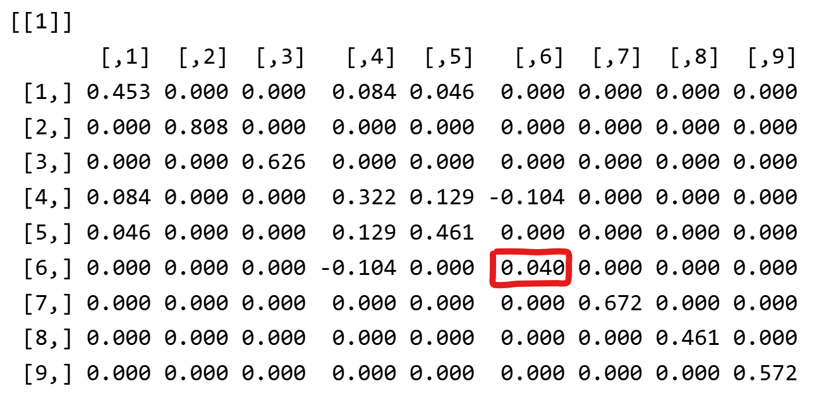
Positive-semidefinite latent covariances: an example
Positive variances with latent

Slide 15

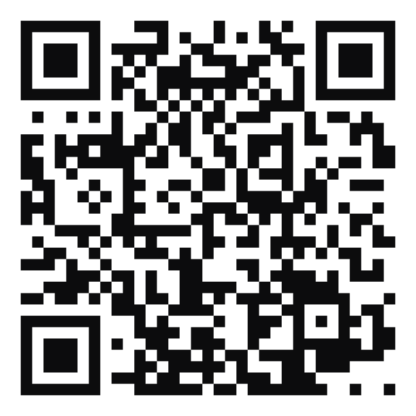
Work in progress…
(Exploratory) Structural Equation Modeling
(Multidimensional) Item Response Theory
Hidden Markov Models
Release date? Soon
Download the beta version at https://github.com/Marcosjnez/latent
Contact: m.j.jimenezhenriquez@vu.nl

